Slide 1
Standard Deviation
Notes:
Title page:
Font size 36, bold, theme color of the chapter (red for geometry, blue for algebra, green for statistics)

Slide 2

Consider the two sets of numbers:
Set A = {1, 2, 3, 4, 5, 6} Set B = {1, 2, 2, 5, 5, 6}
Range of A =
6 – 1 = 5
Range of B =
6 – 1 = 5
IQR of A =
5 – 2 = 3
IQR of B =
5 – 2 = 3
These two sets of data spread out differently, but they have the same range and inter-quartile range. We need a better measure of dispersion.

Slide 3

Consider the two sets of numbers:
Set A = {1, 2, 3, 4, 5, 6} Set B = {1, 2, 2, 5, 5, 6}
Range of A =
6 – 1 = 5
Range of B =
6 – 1 = 5
IQR of A =
5 – 2 = 3
IQR of B =
5 – 2 = 3
In this case, we can use standard deviation to measure the dispersion. As it takes every datum of the set into account, it can tell which set of data are more dispersed.

Slide 4

Standard Deviation of Ungrouped Data
For a set of ungrouped data {x₁, x₂, …, x_{N}},
with
arithmetic mean x,
the standard deviation σ is:
How to find the standard deviations of the data sets A = {1, 2, 3, 4, 5, 6} and B = {1, 2, 2, 5, 5, 6}?

Slide 5

We have to find the arithmetic mean first.
For data set A = {1, 2, 3, 4, 5, 6},

Slide 6

For data set B = {1, 2, 2, 5, 5, 6},
In general, the greater the standard deviation, the greater is the dispersion of the data.
∵ Standard deviation of data set B > standard deviation of data set A
∴ The data in set B are more dispersed.

Slide 7
Another measure of dispersion commonly used in statistics is called the variance, which is equal to σ ².
In general, the greater the variance, the greater is the dispersion of the data.

Slide 8
Follow-up question
At the counter of a post office, 5 mails
are weighted as follows:
23 g, 29 g, 33 g, 19 g, 21 g
Find the mean and the standard deviation of the weights of mails.
(Give your answers correct to 3 significant figures.)
Mean weight of the mails
Standard deviation of the weights of mails

Slide 9

We can also find the values of the mean , the standard deviation and the variance of ungrouped data with a calculator.
Consider the following set of ungrouped data:
10, 39, 41, 23, 38, 17

Slide 10









10, 39, 41, 23, 38, 17
Keying sequences (for CASIO fx-3650P)
Step 1
Press 1 to enter the SD mode.
Step 2
Press 1 to clear all the stored data.
Step 3
Press 10 39 41 23 38 17
Step 4
Press 1 to obtain the mean.
Step 5
Press 2 to obtain the standard deviation.
∴ mean = 28,
standard deviation = 12.0 (cor. to 3 sig. fig.)

Slide 11



Note:
The variance of the data set can be found by pressing
2 .
The variance of the six data is
equal to 143.33...
For CASIO fx-50FH/ fx-50FH II, step 1 will change to
‘Press 4 to enter the SD mode.’.

Slide 12

When the data are organised in a frequency distribution table, we do not need to enter the data one by one. Let’s see the following examples.
Data | 45 | 47 | 51 | 56 | 58
Frequency | 8 | 5 | 7 | 8 | 12

Slide 13














Data | 45 | 47 | 51 | 56 | 58
Frequency | 8 | 5 | 7 | 8 | 12
Keying sequences (for CASIO fx-3650P)
Step 1
Press 1 to enter the SD mode.
Step 2
Press 1 to clear all the stored data.
Step 3
Press 45 4 47 5 51
7 56 8 58 12
Step 4
Press 1 to obtain the mean.
Step 5
Press 2 to obtain the standard deviation.
∴ mean = 52.4,
standard deviation = 5.19 (cor. to 3 sig. fig.)

Slide 14
Follow-up question
The following table shows the number of subjects taken by a group of secondary 5 students.
Number of subjects | 5 | 6 | 7 | 8
Frequency | 2 | 20 | 5 | 3
Find the mean and the standard deviation of the number of subjects taken by the students.
(Give your answers correct to 3 significant figures if necessary.)
Mean = 6.3,
standard deviation = 0.737 (cor. to 3 sig. fig.)

Slide 15
Follow-up question
The following shows the marks of Peter and Susan in
4 tests.
Peter: 78, 81, 80, 85
Susan: 81, 89, 93, 82
(a) Find the standard deviations of the marks of Peter
and Susan.
(Give your answers correct to 3 significant figures.)
(b) Who has a more stable performance in the tests?
Explain your answer.
(a) Standard deviation of marks of Peter (σ_{P})
= 2.55 (cor. to 3 sig. fig.)
Standard deviation of marks of Susan (σ_{S})
= 4.97 (cor. to 3 sig. fig.)

Slide 16
Follow-up question
The following shows the marks of Peter and Susan in
4 tests.
Peter: 78, 81, 80, 85
Susan: 81, 89, 93, 82
(a) Find the standard deviations of the marks of Peter
and Susan.
(Give your answers correct to 3 significant figures.)
(b) Who has a more stable performance in the tests?
Explain your answer.
(b) Since σ_{P} < σ_{S}, the marks of Peter is less dispersed.
Therefore, Peter has a more stable performance in
the tests.

Slide 17
Standard Deviation of Grouped Data
For a set of grouped data with
class marks x₁, x₂, …, x_{N},
if f₁, f₂, …, f_{N} are the corresponding frequencies
and x is the mean,
then the standard deviation σ is defined as:

Slide 18

The following table shows the weights of 10 children.
Weight (kg) | 30 – 32 | 33 – 35 | 36 – 38 | 39 – 41
Frequency | 1 | 3 | 2 | 4
Class mark (kg) | 31 | 34 | 37 | 40
Frequency | 1 | 3 | 2 | 4
To find the standard deviation of grouped data, we should use the class marks to represent each class interval first.

Slide 19

The following table shows the weights of 10 children.
Weight (kg) | 30 – 32 | 33 – 35 | 36 – 38 | 39 – 41
Class mark (kg) | 31 | 34 | 37 | 40
Frequency | 1 | 3 | 2 | 4
= 36.7 kg
We can also use a calculator to find the mean and the standard deviation of grouped data.
Standard deviation of the weight
= 3.13 kg (cor. to 3 sig. fig.)

Slide 20
Follow-up question
The following table shows the ages of contestants of a singing competition.
Age | 14 – 16 | 17 – 19 | 20 – 22 | 23 – 25 | 26 – 28
Frequency | 3 | 8 | 5 | 7 | 2
Find the mean age of the contestants.
Find the standard deviation of the ages of the contestants.
(Give your answer correct to 3 significant figures.)

Slide 21
Follow-up question
The following table shows the ages of contestants of a singing competition.
Age | 14 – 16 | 17 – 19 | 20 – 22 | 23 – 25 | 26 – 28
Frequency | 3 | 8 | 5 | 7 | 2
Find the mean age of the contestants.
Age | 14 – 16 | 17 – 19 | 20 – 22 | 23 – 25 | 26 – 28
Class mark
15
18
21
24
27
Frequency | 3 | 8 | 5 | 7 | 2
= 20.64

Slide 22
Follow-up question
Age | 14 – 16 | 17 – 19 | 20 – 22 | 23 – 25 | 26 – 28
Class mark
15
18
21
24
27
Frequency | 3 | 8 | 5 | 7 | 2
(a) Mean age = 20.64
Find the standard deviation of the ages of the contestants.
(Give your answer correct to 3 significant figures.)
(b) Standard deviation of the ages of the contestants
= 3.53 (cor. to 3 sig. fig.)

Slide 23
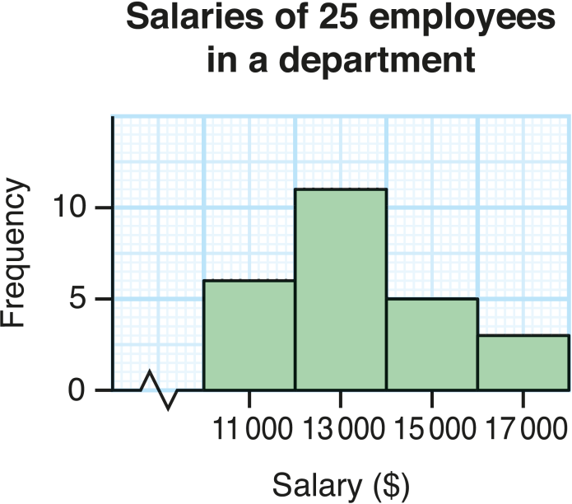
Example:
The histogram on the right shows the distribution of the salaries of 25 employees in a department.
Find the mean and the standard deviation of the salaries of the employees.
Class mark ($) | 11 000 | 13 000 | 15 000 | 17 000
Frequency | 6 | 11 | 5 | 3
∴ mean = $13 400,
standard deviation = $1880 (cor. to 3 sig. fig.)

Slide 24
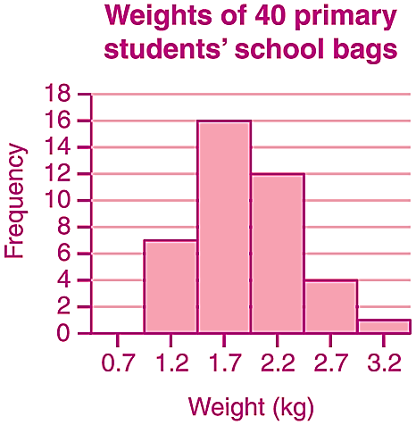
Follow-up question
The histogram on the right shows the distribution of the weights of 40 primary students’ school bags.
Find the mean and the standard deviation of the weights of the school bags.
(Give your answers correct to 3 significant figures if necessary.)
Class mark (kg) | 1.2 | 1.7 | 2.2 | 2.7 | 3.2
Frequency | 7 | 16 | 12 | 4 | 1
Mean weight of the school bags = 1.9 kg,
standard deviation of the weights of the school bags
= 0.485 kg (cor. to 3 sig. fig.)

